Slide 1


A Robot as a Teaching Assistant in an English Class
Elective in Artificial Intelligence
Human-Robot Interaction
Prof. Luca Iocchi
Leandro Maglianella - 1792507

Slide 2
Outline of the presentation
Paper Description
Robot Platform
Teacher-Robot Interaction Models
Experiments
Experimental Observations
Experimental Results
Final Personal Comment

Slide 3
Paper Description

Slide 4
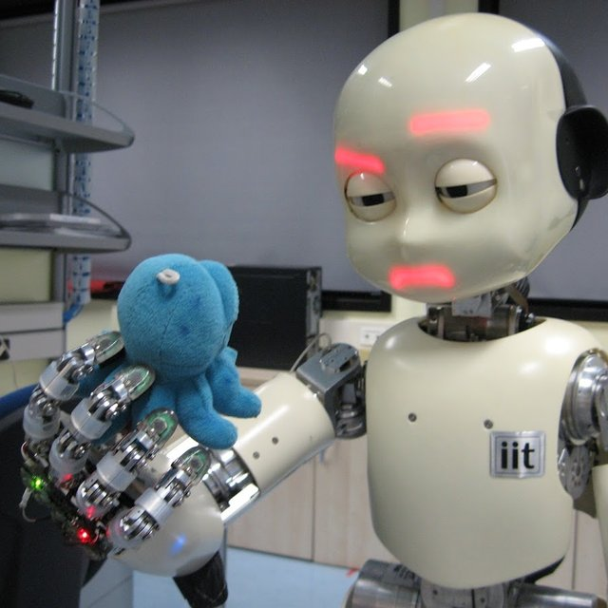

Paper Description
The humanoid physical form makes human-robot social interactions happen in a more natural way
Application domains
Recommender system
Personal assistant
News presenter
Education
Home appliances
Entertainment
…
Concentration
Involvement
Enjoyment
Interest

Slide 5
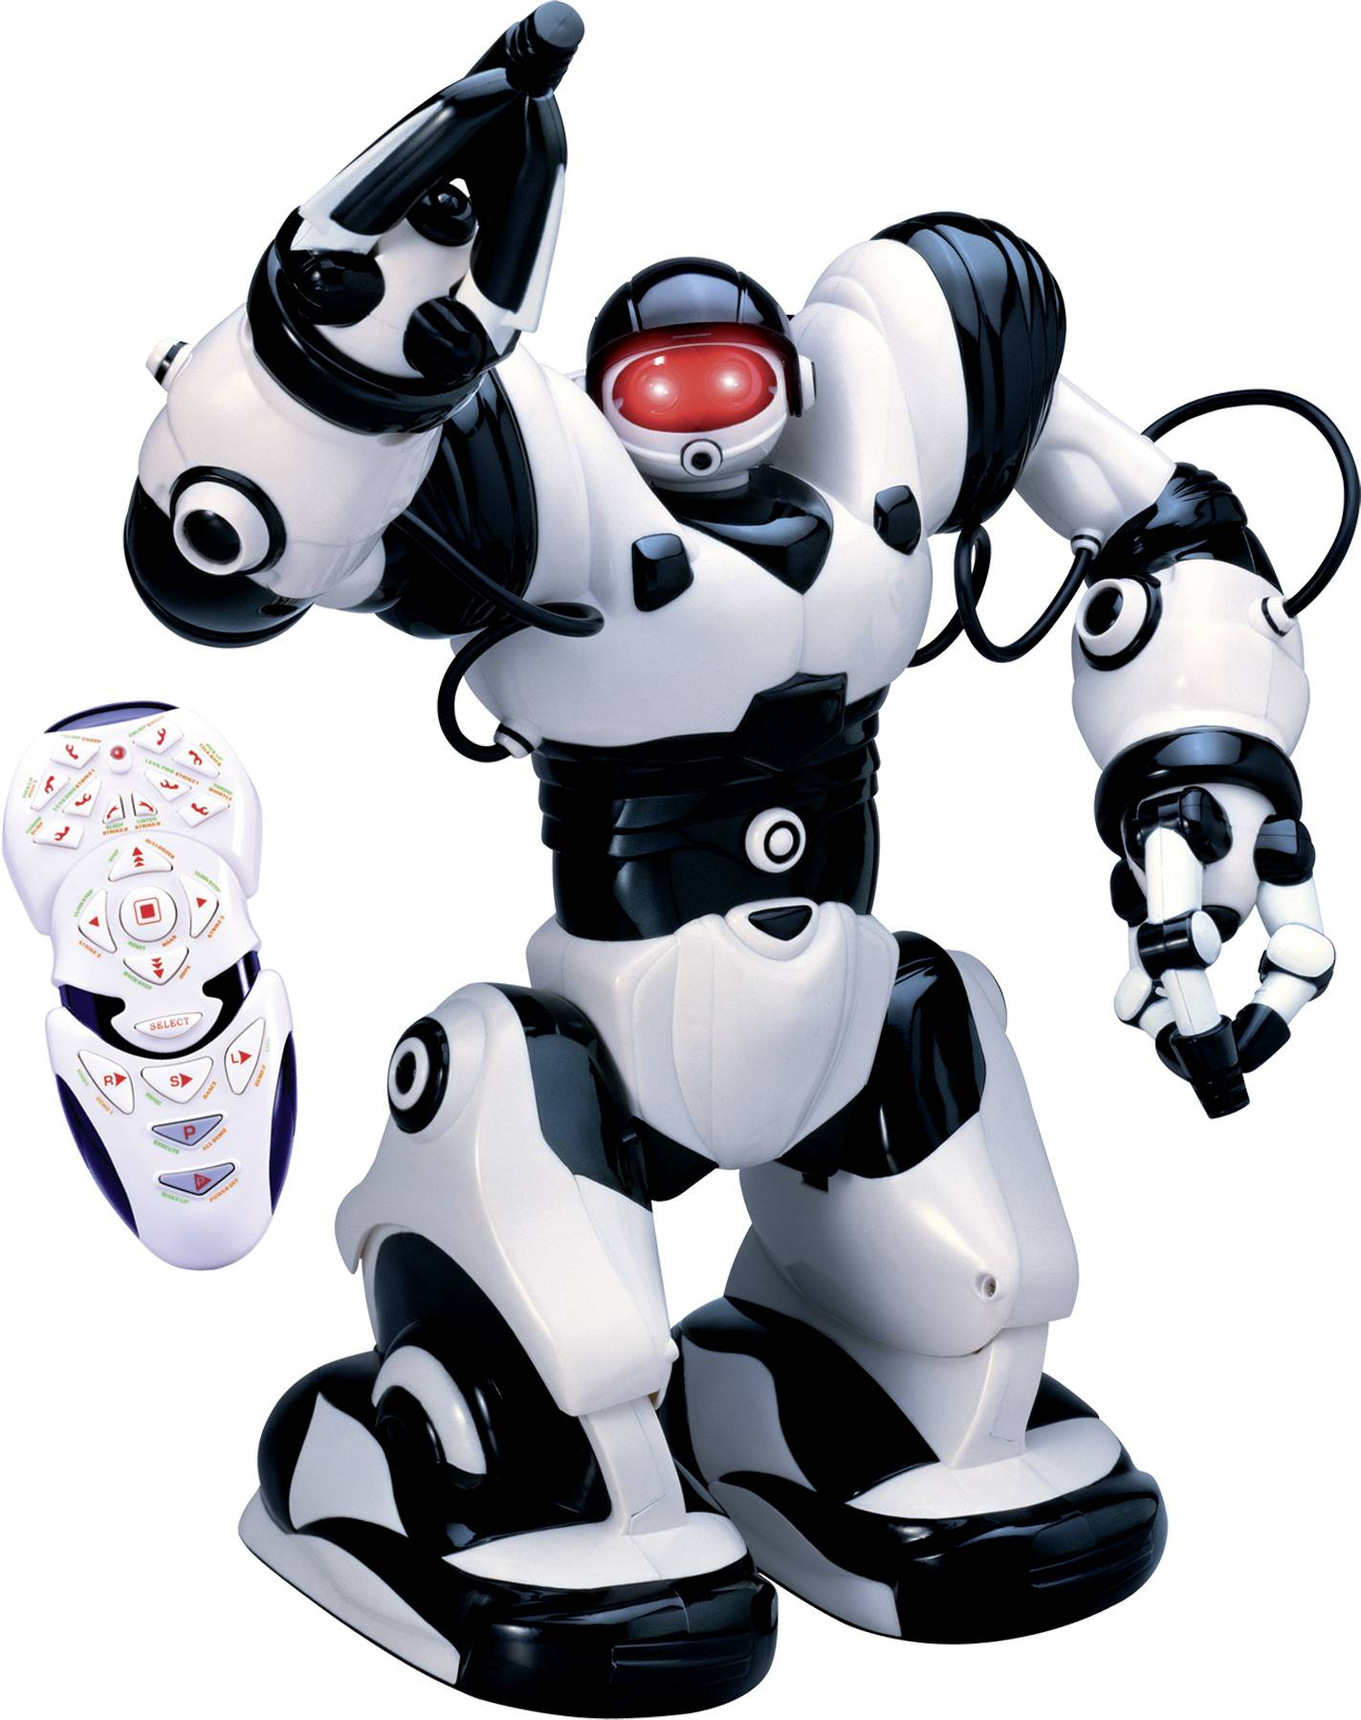
Paper Description
There is a direction worthy of exploration:
Robots as partners of a teacher in a classroom
In particular, this paper explores the use of Robosapien to help teaching English in Taiwanese elementary classrooms
A programmable low-cost humanoid robot
Produced for the toy market by WowWee

Slide 6
Robot Platform

Slide 7
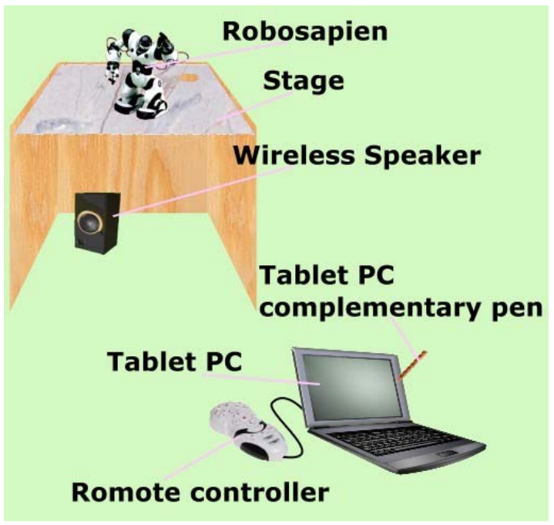
Robot Platform
The Robot Platform consists in a combination of various pieces of Hardware and Software
Height: 36cm
Weights: 2.1kg
4 "D" alkaline batteries
Eye lights and comic sounds for emotional state
Robosapien's remote controller was extended with a DSP board that is connected to a Tablet PC

Slide 8
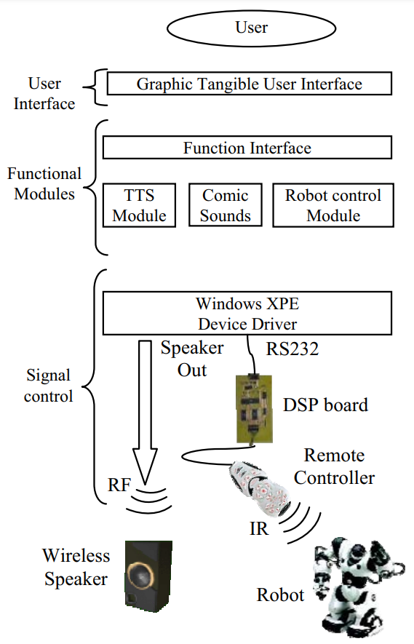
Robot Platform
The Robot Platform consists in a combination of various pieces of Hardware and Software
Software integrates speeches, sounds and gestures control of the robot
Speech of the robot is generated by Microsoft Speech SDK for text-to-speech
The speaking rate, identity of the voice, and volume could be adjusted in real-time to fit the requirements

Slide 9
Teacher-Robot Interaction Models

Slide 10

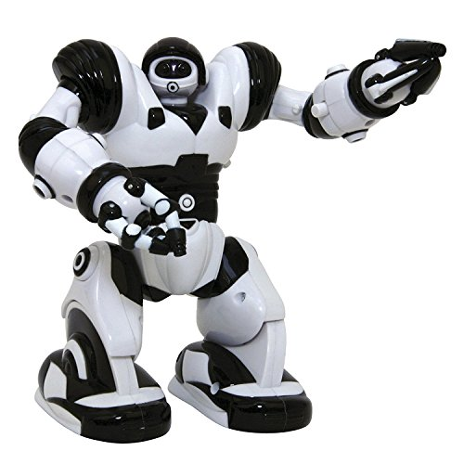



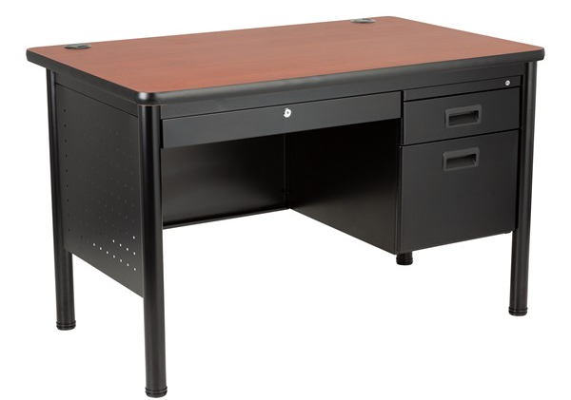
Teacher-Robot Interaction Models
Five methods for teacher-robot collaboration are proposed:
1. Storytelling Model
Let Sapien tell us a story
Once upon a time..
What happens in the story?
Right answer!
2. Q&A Model
Two!
Yay!
What’s 1+1?
Student X, come here!
Five..?
Noo!

Slide 11
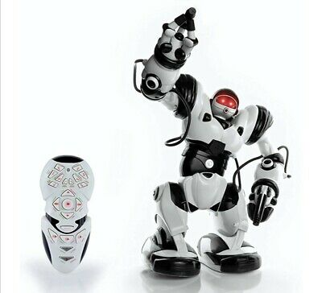



Teacher-Robot Interaction Models
Yay!
Let’s dance!
3. Cheerleader Model
Let’s do a competition!
Q&A
Picking the corresponding word or picture
Performing actions
4. Let’s Act Model
Let’s act!
Do this action!
Do this action!
Noo!
I cannot do it
5. Pronunciation Leading Model
Sapien, lead them!
Cat!
Cat!

Slide 12
Experiments
Observations and Results

Slide 13
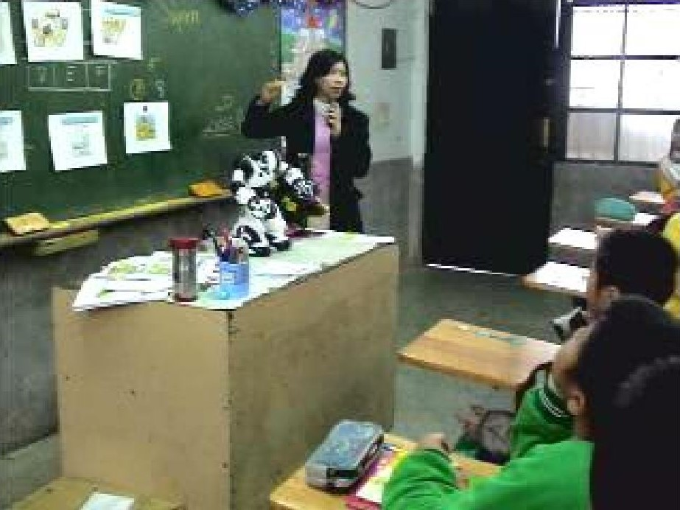
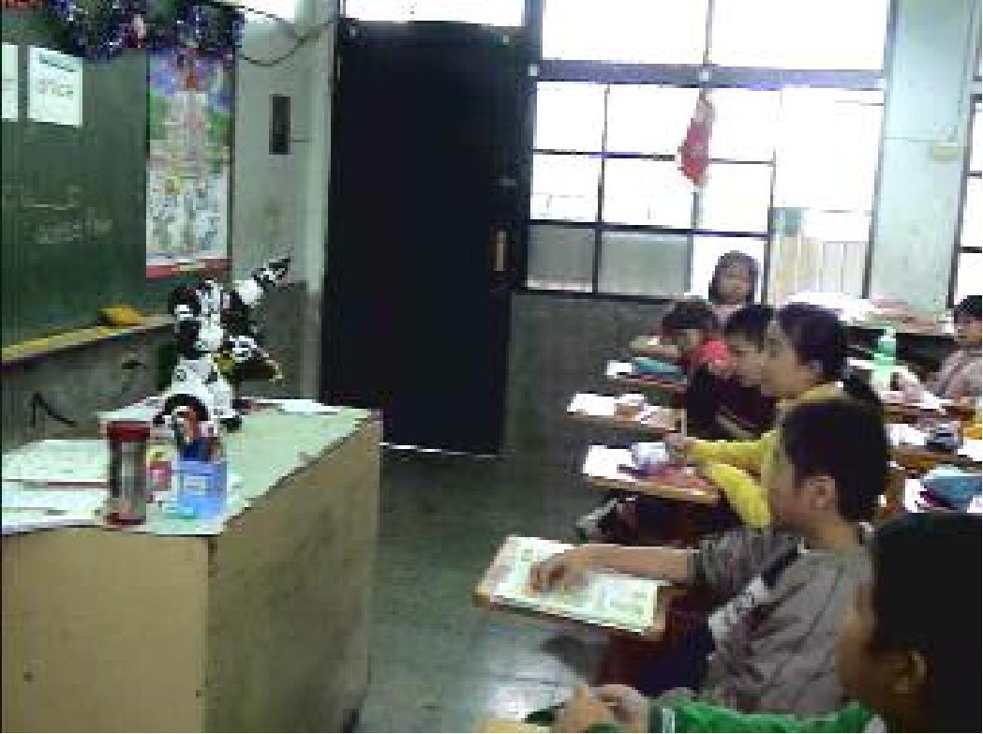
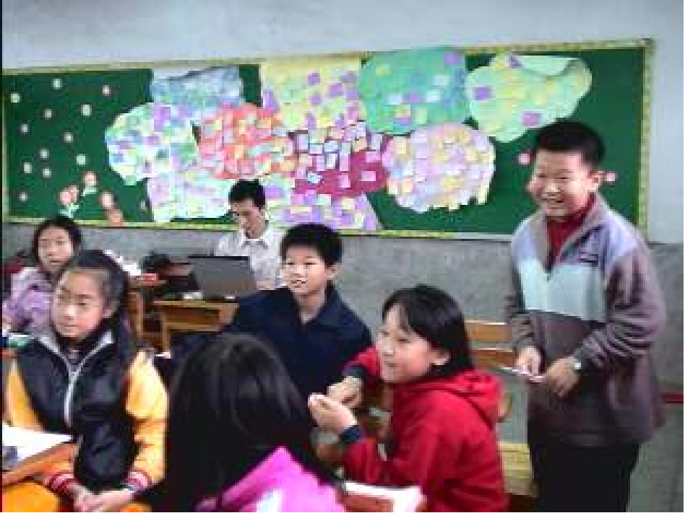
Experiments
Three fifth grade classes (11 years old students) were involved in the experiments:
class A (33 students)
class B (35 students)
class C (32 students)
The teacher of these three classes is the same
For each class, the experiment was carried out in two lessons (40 minutes each) in two consecutive weeks

Slide 14
Experimental Observations
1. Storytelling Model
All the students were very excited and focused in listening and watching what the robot was doing. Most students desired to answer the teacher's question about the story. Usually, the students are not so involved in the activities.
2. Q&A Model
Some students were excited when the robot called them, but most of them were shy.
3. Cheerleader Model
Students participated in the competition activities more enthusiastically than usual.
4. Let’s Act Model
Most students could follow what the robot ordered them to do. In the second part, at the beginning the students gave simple commands that Robosapien could do. Later, students began making fun of it, ordering it to perform some actions that it could not do.
5. Pronunciation Leading Model
Students repeat loudly full of joy after the robot. We believe the students were more willing to speak in English while the robot cheered them.

Slide 15
Experimental Results
Q1. When the robot cheers me, I feel very happy.
Q2. I think the robot's motion is very funny.
Q3. The robot can always attract me to the content of the class.
Q4. I like the robot's speaking more than the CD player.
Q5. The robot makes me like more this class.
Q6. The robot performs with the teacher very well.
Q7. I wish the robot will appear again in class next time.
 | Class A |  | Class B |  | Class C
Questions | M | SD | M | SD | M | SD
Q1. | 3.61 | 1.20 | 4.24 | 1.28 | 3.97 | 1.23
Q2. | 4.12 | 0.99 | 4.41 | 1.16 | 4.10 | 1.42
Q3. | 3.58 | 1.17 | 3.77 | 1.35 | 3.94 | 1.09
Q4. | 3.67 | 1.27 | 3.86 | 1.17 | 3.94 | 1.22
Q5. | 3.79 | 1.17 | 3.97 | 1.25 | 3.75 | 1.39
Q6. | 3.97 | 1.06 | 4.06 | 1.28 | 4.32 | 1.01
Q7. | 4.09 | 1.42 | 4.46 | 1.20 | 4.41 | 1.24

Slide 16
Final Personal Comment

Slide 17
Final Personal Comment
Given the observations and results, the presence of a robot is positive even in the classroom domain.
Important Aspects: Novelty Effect and Teacher Understanding.
Suggestions:
Longer experimental period
More teachers/classes
Use a better performing robot
Our project also aims at including a reasoning module.

Slide 18
References
Zhen-Jia Y., Chi-Yuh S., Chih-Wei C., Baw-Jhiune L., Gwo-Dong C.
"A Robot as a Teaching Assistant in an English Class", 2006 Sixth International Conference on Advanced Learning Technologies

